Slide 1
DEVICE SENSOR
Week 13 - Advanced Native Mobile Programming

Slide 2
TABLE OF CONTENTS
01
02
03
THE CONCEPT
TUTORIAL 2-6
HOMEWORK
Describe the basic concept of smartphone sensor
Hands on tutorial to understand the implementation of Android sensor
Fun homework to improve your knowledge and creativeness

Slide 3
THE CONCEPT
01
Common Sensor, Handle Sensor, Sensor Coordinate System, Best Practice

Slide 4
Common Sensor
Motion Sensors
Position Sensors
Environment Sensors

Slide 5
Motion Sensor
Motion sensors are useful for monitoring device movement, such as tilt, shake, rotation, or swing.
App Example:
Motion gesture as controller: Steering car game, swing bowling game, fishing game
Fitness app: step counter
Anti theft app: trigger alarm if phone detect subtle movement

Slide 6
Motion Sensor
Accelerometer (detect acceleration along axis, include gravity)
Gravity (detect gravity force along axis)
Gyroscope (rate of device rotation around axis)
Step Counter (Number of steps taken by the user since the last reboot while the sensor was activated)

Slide 7
Position Sensor
Position sensors are useful for determining a device's physical position in the world's frame of reference.
For example, you can use the geomagnetic field sensor in combination with the accelerometer to determine a device's position relative to the magnetic north pole

Slide 8
Position Sensor
Accelerometer (detect acceleration along axis, include gravity)
Geomagnetic (detect geomagnetic field strength along axis)
Proximity (detect distance from object in cm)

Slide 9
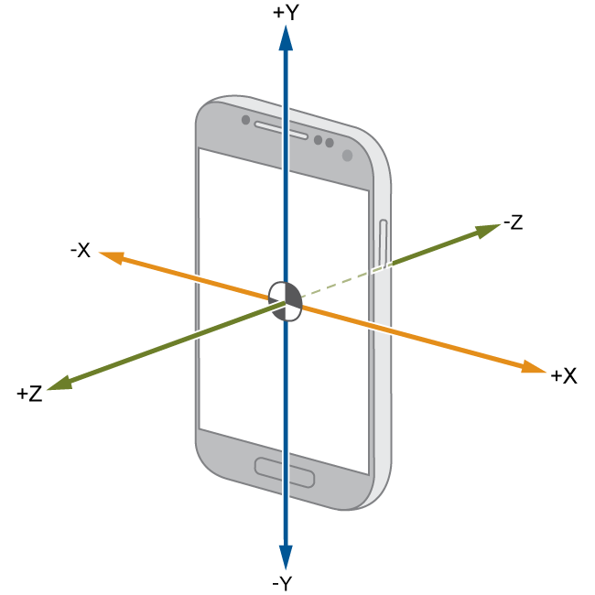
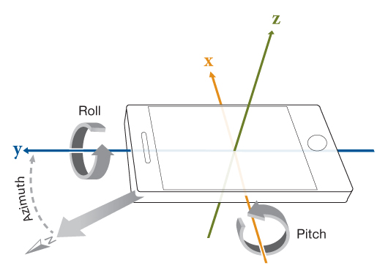
Accelerometer and Gyroscope

Slide 10
Environment Sensor
These sensors is used to monitor relative ambient humidity, illuminance, ambient pressure, and ambient temperature near an Android-powered device.

Slide 11
Environment Sensor
Temperature (detect temperature around device in Celsius)
Pressure (detect air pressure around device in hPa)
Light (detect light intensity around device in lx)

Slide 12
Handle Sensor
SensorManager Class to create an instance of the sensor service, accessing and listing sensors, registering and unregistering sensor event listeners, and acquiring orientation information.
SensorEvent the raw sensor data, the type of sensor that generated the event, the accuracy of the data, and the timestamp for the event.
SensorEventListener
Interface callback that receive notifications (sensor events) when sensor values change or when sensor accuracy changes.

Slide 13
Handle Sensor
Typical use in app:
Identifying sensors and sensor capabilities
Monitor sensor events

Slide 14
Identifying Sensor & Capabilities
private lateinit var sensorManager: SensorManager
...
sensorManager = getSystemService(Context.SENSOR_SERVICE) as SensorManager if (sensorManager.getDefaultSensor(Sensor.TYPE_MAGNETIC_FIELD) != null) {
// Success! There's a magnetometer.
} else {
// Failure! No magnetometer.
}

Slide 15
Monitoring Sensor Events
sensorManager = getSystemService(Context.SENSOR_SERVICE) as SensorManager
mLight = sensorManager.getDefaultSensor(Sensor.TYPE_LIGHT)
. . .
override fun onResume() {
super.onResume()
mLight?.also { light ->
sensorManager.registerListener(this, light, SensorManager.SENSOR_DELAY_NORMAL)
}
}

Slide 16
Monitoring Sensor Events
override fun onSensorChanged(event: SensorEvent) {
// The light sensor returns a single value.
// Many sensors return 3 values, one for each axis.
val lux = event.values[0]
// Do something with this sensor value.
}

Slide 17
Sensor Delay
SENSOR_DELAY_NORMAL (default delay) is suitable for monitoring typical screen orientation changes and uses a delay of 200,000 microseconds.
SENSOR_DELAY_GAME (20,000 microsecond delay)
SENSOR_DELAY_UI (60,000 microsecond delay)
SENSOR_DELAY_FASTEST (0 microsecond delay)
Notes: Using a larger delay imposes a lower load on the processor and therefore uses less power.

Slide 18
Best Practice
As a best practice you should always disable sensors you don't need, especially when your activity is paused. Failing to do so can drain the battery in just a few hours because some sensors have substantial power requirements and can drain battery power quickly. The system will not disable sensors automatically when the screen turns off. override fun onPause() {
super.onPause()
sensorManager.unregisterListener(this)
}

Slide 19
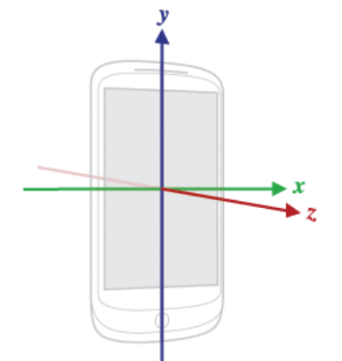
Sensor Coordinate System
The most important point to understand about this coordinate system is that the axes are not swapped when the device's screen orientation changes
the sensor's coordinate system never changes as the device moves.

Slide 20
Emulate Sensor Using Emulator

Slide 21
TUTORIAL
02
Accelerometer, Gyroscope, Light, Proximity

Slide 22
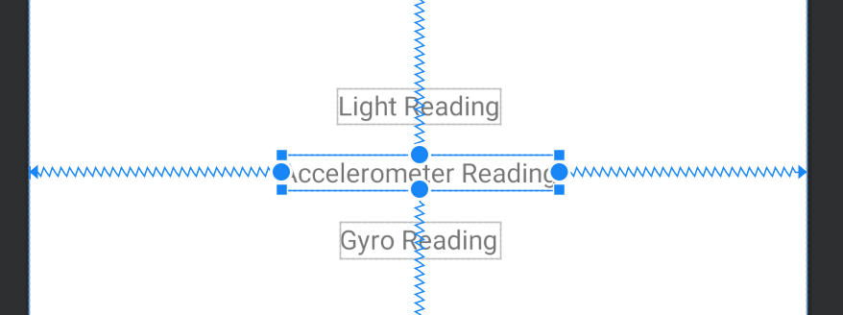
START NEW PROJECT
Create new Android Studio project, name it as week13
Design the layout like following screenshot

Slide 23
ENABLE KOTLIN EXTENSION
Open gradle (module)
Enable kotlin extension
plugins {
id 'com.android.application'
id 'kotlin-android'
id 'kotlin-android-extensions'
}

Slide 24
SETUP SENSOR MANAGER
class MainActivity : AppCompatActivity(), SensorEventListener {
private lateinit var sensorManager: SensorManager private var accelerometerReading = FloatArray(3)
override fun onCreate(savedInstanceState: Bundle?) {
super.onCreate(savedInstanceState)
setContentView(R.layout.activity_main)
sensorManager = getSystemService(Context.SENSOR_SERVICE) as SensorManager
}

Slide 25
IDENTIFY SENSOR
private var accelerometerSensor: Sensor? = null
override fun onCreate() {
. . .
accelerometerSensor = sensorManager.getDefaultSensor(Sensor.TYPE_ACCELEROMETER)
}

Slide 26
REGISTER SENSOR LISTENER
override fun onResume() {
super.onResume()
if (accelerometerSensor != null) {
Toast.makeText(this, "Accelerometer Sensor detected", Toast.LENGTH_SHORT).show()
sensorManager.registerListener(this, accelerometerSensor,
SensorManager.SENSOR_DELAY_FASTEST)
} else {
Toast.makeText(this, "No Accelerometer sensor detected", Toast.LENGTH_SHORT).show()
}
}

Slide 27
MONITORING SENSOR EVENT
class MainActivity : AppCompatActivity(), SensorEventListener { . . . override fun onSensorChanged(p0: SensorEvent?) { } override fun onAccuracyChanged(p0: Sensor?, p1: Int) {
}
}
Implement SensorEventListener interface

Slide 28
MONITORING SENSOR EVENT
class MainActivity : AppCompatActivity(), SensorEventListener { . . . override fun onSensorChanged(p0: SensorEvent?) { if(p0!!.sensor.type == Sensor.TYPE_ACCELEROMETER) { accelerometerReading = p0.values var x = p0.values[0]
var y = p0.values[1]
var z = p0.values[2] txtMsg.text = “x: $x, y: $y; z: $z” } }
}
x,y,z indicates acceleration strength along each axis

Slide 29
UNREGISTER LISTENER
If you plan to test these tutorials on real device, don’t forget to override onPause() to not drain your device’s battery power override fun onPause() {
super.onPause()
sensorManager.unregisterListener(this)
}

Slide 30
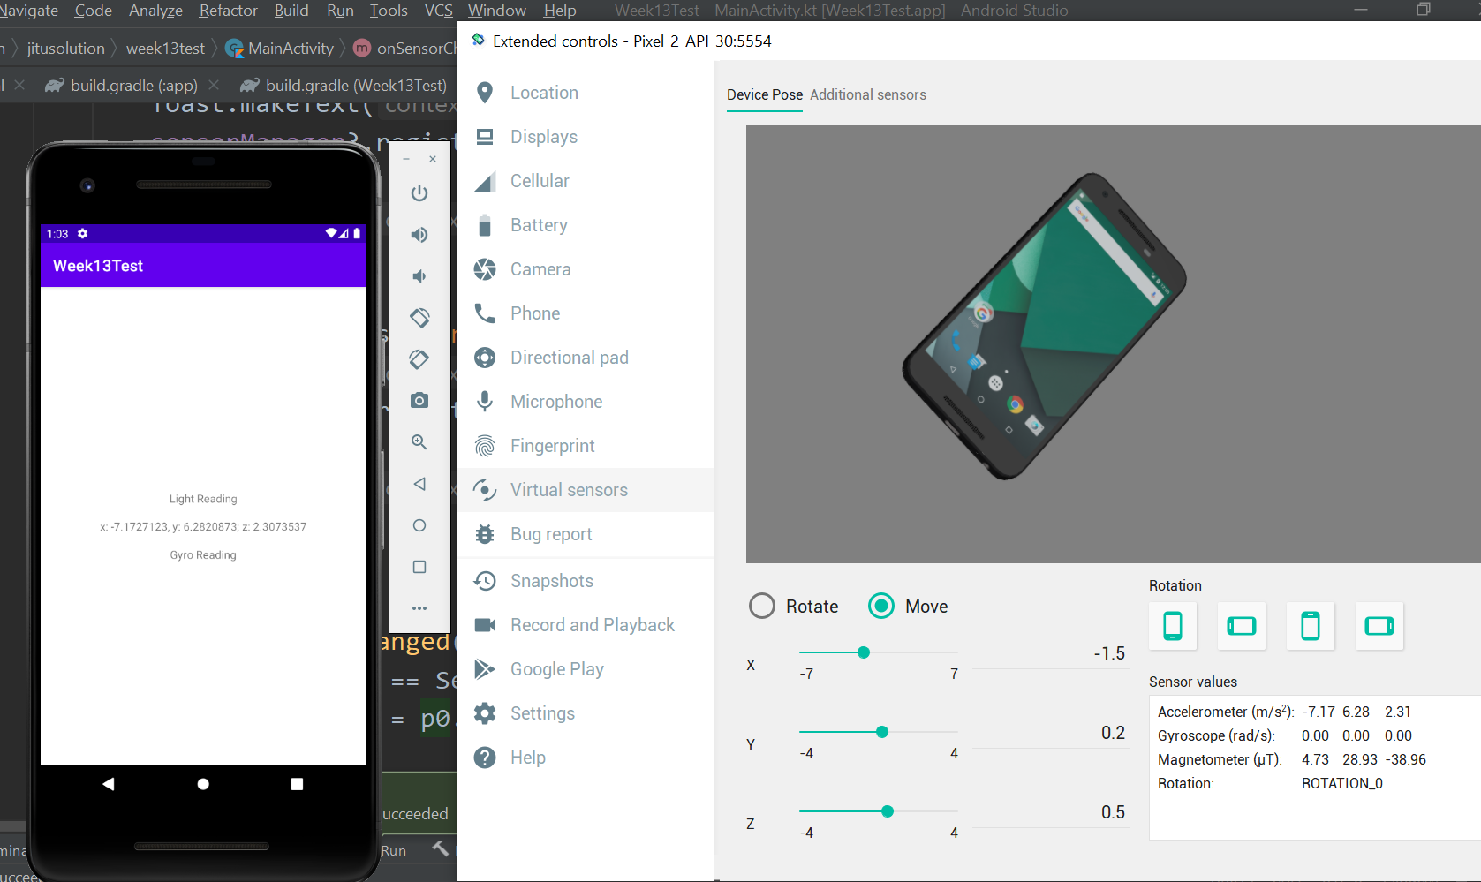
TEST USING EMULATOR
Click and drag the device. Check the reading
Click triple dot

Slide 31
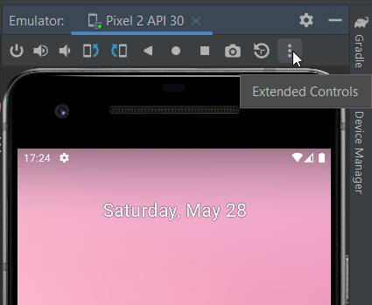
EMBEDDED EMULATOR?
If your emulator is embedded within Android Studio (not a pop-up window), click the kebab menu (three vertical dots) to access extended controls

Slide 32
TUTORIAL
03
Create Step Counter

Slide 33
STEP COUNTER
Step counter utilizes a pedometer sensor, primarily available on wearable devices such as a smartwatch or smart wristband.
It tracks the number of steps taken by the user. Commonly used as central features of fitness app.
Without a pedometer, devices can record steps by utilizing an accelerometer sensor

Slide 34
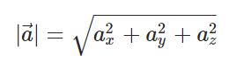
ACCELEROMETER MAGNITUDE
Accelerator magnitude is used to calculate the acceleration strength. The result may be used to detect significant device motion as an indication of steps that occurred
This equation will yield the exact gravity value 9.81 m/s² if device is resting. Any changes on any axis will adjust the magnitude as well.

Slide 35
STEP COUNTER THRESHOLD
Find differences between current magnitude compared with previous value. If the differences is great enough (more than 6), add the step counter.
Therefore, it requires to record previous magnitude overtime

Slide 36
ACCELEROMETER MAGNITUDE
class MainActivity : AppCompatActivity(), SensorEventListener {
private var sensorManager:SensorManager? =null
private var previousV:Float ?= null
private var stepCount:Int = 0

Slide 37
ACCELEROMETER MAGNITUDE
override fun onSensorChanged(p0: SensorEvent?) { if(p0!!.sensor.type == Sensor.TYPE_ACCELEROMETER) {
var x = p0.values[0]
var y = p0.values[1]
var z = p0.values[2]
var v = sqrt(x.pow(2) + y.pow(2) + z.pow(2))
v is the accelerator magnitude

Slide 38
ACCELEROMETER MAGNITUDE
var v = sqrt(x.pow(2) + y.pow(2) + z.pow(2))
if (previousV != null) {
var dif = v - previousV!!
if (dif > 6) {
stepCount++
txtStep.text = "$stepCount steps"
}
} previousV = v
Threshold is 6. Adjust it to achieve better result.

Slide 39
TEST USING REAL DEVICES
Try to walk around with app shows in foreground.
Notice the steps counter increases.
Give a hard tap on back of phone to simulate the steps

Slide 40
TUTORIAL
04
Use Gyroscope Sensor

Slide 41
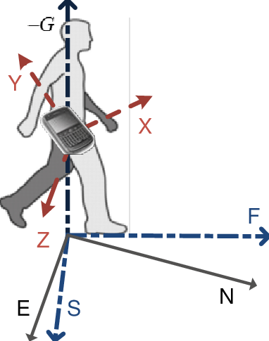
DEVICE ORIENTATION
To find the device’s orientation, you first need to determine its rotation matrix.
A rotation matrix helps map points from the device’s coordinate system to the real-world coordinate system.
SensorManager.getRotationMatrix is used to return the RotationMatrix

Slide 42
DEVICE ORIENTATION
SensorManager.getOrientation() is used to return the orientation value of the devices in radians
There are three values returned:
Azimuth - the rotation of z axis
Roll - the rotation of y axis
Pitch - the rotation of x axis

Slide 43
AZIMUTH
Degrees of rotation around –Z axis
Angle between device’s Y axis (top edge of device) and Earth’s magnetic North pole: N = 0, S = 180, W = -90, E = 90
If you need to work with positive values only, simply add by 360, then perform a modulo by 360, so: N = 0, S = 180, W = 270, E = 90

Slide 44
PITCH
Degrees of rotation around X axis
If you hold your device parallel to the ground in this config:
Bottom edge faces you
Screen is face up
Tilting the top edge towards the ground produces a positive pitch value
Range is -90 to 90

Slide 45
ROLL
Degrees of rotation around Y axis
If you hold your device parallel to the ground in this config:
Bottom edge faces you
Screen is face up
Tilting the left edge towards the ground produces a positive roll value
Range is -180 to 180

Slide 46
PREPARE THE MATRIX
class MainActivity : AppCompatActivity(), SensorEventListener {
private var sensorManager:SensorManager? =null
private var previousV:Float ?= null
private var stepCount:Int = 0
private var magneticReading = FloatArray(3)
private var accelerometerReading = FloatArray(3)

Slide 47
SETUP SENSOR
private var geomagneticSensor: Sensor? = null
override fun onCreate() {
. . .
geomagneticSensor = sensorManager.getDefaultSensor(Sensor.TYPE_MAGNETIC_FIELD)

Slide 48
REGISTER SENSOR LISTENER
override fun onResume() {
super.onResume()
. . .
if (geomagneticSensor != null) {
Toast.makeText(this, "Magnetic Field Sensor detected", Toast.LENGTH_SHORT).show()
sensorManager.registerListener(this, geomagneticSensor, SensorManager.SENSOR_DELAY_FASTEST)
} else {
Toast.makeText(this, "No Magnetic Field Sensor detected", Toast.LENGTH_SHORT).show()
}

Slide 49
STORE THE READING
override fun onSensorChanged(p0: SensorEvent?) {
if(p0!!.sensor.type == Sensor.TYPE_MAGNETIC_FIELD) {
magneticReading = p0.values
}
if(p0!!.sensor.type == Sensor.TYPE_ACCELEROMETER) {
accelerometerReading = p0.values
// and everything else about step counter
}

Slide 50
FIND ORIENTATION
var rotationMatrix = FloatArray(9)
var orientationAngles = FloatArray(3)
SensorManager.getRotationMatrix(rotationMatrix, null,
accelerometerReading,magneticReading)
SensorManager.getOrientation(rotationMatrix, orientationAngles)

Slide 51
FIND ORIENTATION
The results are in radians, so they need to be converted into degrees. We also convert them to positive values
var azimuth = (Math.toDegrees(orientationAngles[0].toDouble()) + 360.0) % 360.0
var pitch = (Math.toDegrees(orientationAngles[1].toDouble()) + 360.0) % 360.0
var roll = (Math.toDegrees(orientationAngles[2].toDouble()) + 360.0)%360.0
txtGyro.text = "Az=" + (azimuth*100)/100 + "\nPitch=" + (pitch*100)/100 + "\nRoll=" + (roll*100)/100
You might want to work with original values and test this on your real device to better understand azimuth/pitch/roll values

Slide 52
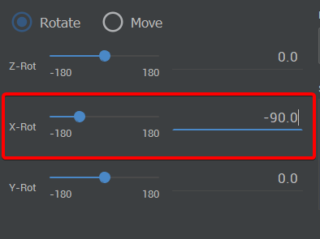
Testing in Emulator?
To produce the same value as the documentation suggests (bottom edge of device is facing us and screen is facing up), set the X-rot to -90, then play the rotation values
Notice something strange with roll value?

Slide 53
TUTORIAL
05
Use Light Sensor

Slide 54
LIGHT SENSOR
This sensor measures how much intensity of light hits the device sensor.
It returns a single value of lumens (a measure of the total quantity of visible light emitted by a source per unit of time)
Application example:
An app that trigger dark mode if light intensity low
Auto adjusting brightness when watching video based on light intensity

Slide 55
SETUP SENSOR
private var lightSensor: Sensor? = null
override fun onResume() {
. . .
val lightSensor = sensorManager.getDefaultSensor(Sensor.TYPE_LIGHT)
}

Slide 56
REGISTER SENSOR LISTENER
override fun onResume() {
. . .
if (lightSensor != null) {
Toast.makeText(this, "Light Sensor detected", Toast.LENGTH_SHORT).show()
sensorManager.registerListener(this, lightSensor, SensorManager.SENSOR_DELAY_FASTEST)
} else {
Toast.makeText(this, "No Light Sensor detected", Toast.LENGTH_SHORT).show()
}

Slide 57
SENSOR READING
override fun onSensorChanged(p0: SensorEvent?) {
. . .
if(p0.sensor.type ==Sensor.TYPE_LIGHT) {
txtLight.text = p0.values[0].toString()
} }

Slide 58
TUTORIAL
06
Use Proximity Sensor

Slide 59
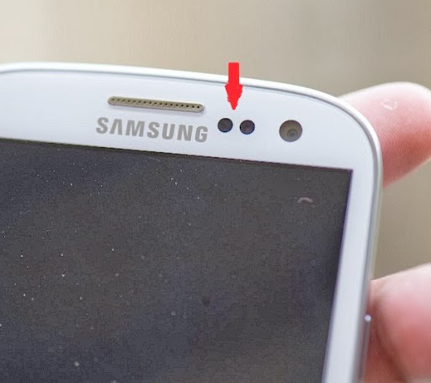
PROXIMITY SENSOR
Some devices may accurately shows distance number between object and phone screen (in cm)
Other devices simply shows two values (near or far)
App Example: disable the screen when you hold the phone close to your face while you are on a call

Slide 60
SETUP SENSOR
private var proximitySensor: Sensor? = null
override fun onCreate() {
. . .
proximitySensor = sensorManager.getDefaultSensor(Sensor.TYPE_LIGHT)

Slide 61
REGISTER SENSOR LISTENER
override fun onResume() {
. . .
if (proximitySensor != null) {
Toast.makeText(this, "Proximity Sensor detected", Toast.LENGTH_SHORT).show()
sensorManager.registerListener(this, proximitySensor, SensorManager.SENSOR_DELAY_FASTEST)
} else {
Toast.makeText(this, "No ProximitySensor detected", Toast.LENGTH_SHORT).show()
}

Slide 62
READING SENSOR DATA
override fun onSensorChanged(p0: SensorEvent?) {
if (p0!!.sensor.type == Sensor.TYPE_PROXIMITY) {
txtLight.text = p0.values[0].toString()
if(p0.values[0] <= 0.0) {
AppCompatDelegate.setDefaultNightMode(
AppCompatDelegate.MODE_NIGHT_YES)
}
}
. . .
Change app theme to use night mode theme

Slide 63
TEST USING REAL DEVICES
Try to cover the proximity sensor (near front face camera)
Notice that app now switch to dark mode theme

Slide 64
HOMEWORK

Slide 65
APP IDEAS
Give me your best idea about an app that uses several different sensors
It could be a entertainment app, game, productivity, health tracker app, etc.
Describe your ideas in 2 paragraphs that contains:
What kind of sensor that uses by the app
What the purpose of those sensor in your app
Answers should be posted in ULS

Slide 66
THANKS
Do you have any questions?
andre@staff.ubaya.ac.id
Please keep this slide for attribution

Slide 67


